Slide 1
Design and Implement Cloud Data Platform Solutions

Slide 2
01 | Microsoft Cloud Data Platform

Slide 3
Agenda
1
Microsoft Cloud Data Platform
5
Hybrid HA/DR Scenarios with SQL Server
2
Implement SQL Server on Azure VM
6
Design and Implement Security
3
Implement SQL Database
7
Monitor and Manage Implementations on Azure
4
SQL Database High Availability and Disaster Recovery
8
Design and Implement Database Solutions for SQL Server and SQL Database

Slide 4
In this module
Microsoft Cloud Data Platform
Data Visualizations
Microsoft SQL Server
Cortana Analytics Suite
Common Tools
Cloud Data Offerings

Slide 5













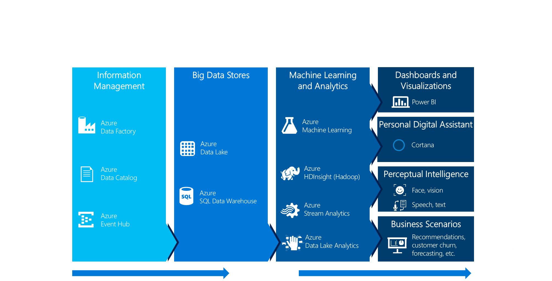

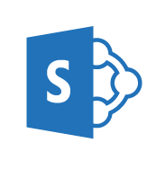

LRS – Geo-Replication
MICROSOFT CLOUD DATA PLATFORM
CLOUD
DATA VISUALIZATION
MICROSOFT DATA PLATFORM
Analyze and Authoring
ON PREMISES
SQL Server in Azure VM
SQL Database + Elastic Scale
Analytical Reports
AG -Async replica
Azure Marketplace
Microsoft Excel
Power BI Desktop
Database Engine
BI and Advanced Analytics
Mobile Reports
SQL Server Database Engine
DocumentDB
Redis Cache
Azure HDInsight
Mobile Report Publisher
Analysis Services
Tabular, Multi-Dimensional
PowerPivot, Data Mining, KPI, BISM
Map Reduce, Pig, Hive, Hbase, Storm, Spark
Paginated Reports
Relational, XML, JSON, Spatial, FullText, Binary, Image, FileTable, Filestream
Row level security, Transparent Data Encryption, Always Encrypted, Data Masking, Auditing, Compliance
Report Builder
Transactional Replication
Blob Storage
Table Storage
Report Designer
In-Memory
SQL Agent, Database Mail, Linked Servers, Managed Backup, Backup to Azure
Reporting Services Native, SharePoint Integrated
Buffer Pool Ext.
Columnstore
MPP
Delivery
Query Store
Row Store
R Services
Azure SQL Data Warehouse
Azure Data Lake Store
Cloud
StretchDB
Resource Governor
Power BI Service
On-Premises
Information Management & Data Orchestration
HA/DR
Data Warehousing
Dimensional Modeling, Star, Snowflake, Polybase
SQL Reporting Services
Always On
Azure Data Factory
Azure Data Catalog
Azure Search
Consume
Data Quality Services
Master Data Services
Replication
Integration Services
Log Shipping
FCI
AG
Power BI Web Portal
Reference Architectures
Appliances
Polybase
Stream Analytics
Azure Data Lake Analytics
Windows Phone App
Physical / Virtual Deployment
Polybase
Event Hub
Azure ML
APS Massively Parallel Processing
Android App
iOS App
Common Tools
Reporting Services Portal
SQL Server Management Studio
SQL Server Data Tools
Command Line (PowerShell, BCP, SQLCMD)
Migration & Upgrade Tools (SSMA, Upgrade Advisor, Map Toolkit)
SharePoint
Cortana

Slide 6
MICROSOFT CLOUD DATA PLATFORM
LRS – Geo-Replication
MICROSOFT DATA PLATFORM
CLOUD
DATA VISUALIZATION
Analyze and Authoring
ON PREMISES
SQL Server in Azure VM
SQL Database + Elastic Scale
Analytical Reports
AG -Async replica
Azure Marketplace
Microsoft Excel
Power BI Desktop
Database Engine
BI and Advanced Analytics
Mobile Reports
SQL Server Database Engine
DocumentDB
Redis Cache
Azure HDInsight
Mobile Report Publisher
Analysis Services
Tabular, Multi-Dimensional
PowerPivot, Data Mining, KPI, BISM
Map Reduce, Pig, Hive, Hbase, Storm, Spark
Paginated Reports
Relational, XML, JSON, Spatial, FullText, Binary, Image, FileTable, Filestream
Row level security, Transparent Data Encryption, Always Encrypted, Data Masking, Auditing, Compliance
Report Builder
Transactional Replication
Blob Storage
Table Storage
Report Designer
In-Memory
SQL Agent, Database Mail, Linked Servers, Managed Backup, Backup to Azure
Reporting Services Native, SharePoint Integrated
Buffer Pool Ext.
Columnstore
MPP
Delivery
Query Store
Row Store
R Services
Azure SQL Data Warehouse
Azure Data Lake Store
Cloud
StretchDB
Resource Governor
Power BI Service
On-Premises
Information Management & Data Orchestration
HA/DR
Data Warehousing
Dimensional Modeling, Star, Snowflake, Polybase
SQL Reporting Services
Always On
Azure Data Factory
Azure Data Catalog
Azure Search
Consume
Data Quality Services
Master Data Services
Replication
Integration Services
Log Shipping
FCI
AG
Power BI Web Portal
Reference Architectures
Appliances
Polybase
Stream Analytics
Azure Data Lake Analytics
Windows Phone App
Physical / Virtual Deployment
Polybase
Event Hub
Azure ML
APS Massively Parallel Processing
Android App
iOS App
Common Tools
Reporting Services Portal
SQL Server Management Studio
SQL Server Data Tools
Command Line (PowerShell, BCP, SQLCMD)
Migration & Upgrade Tools (SSMA, Upgrade Advisor, Map Toolkit)
SharePoint
Cortana

Slide 7
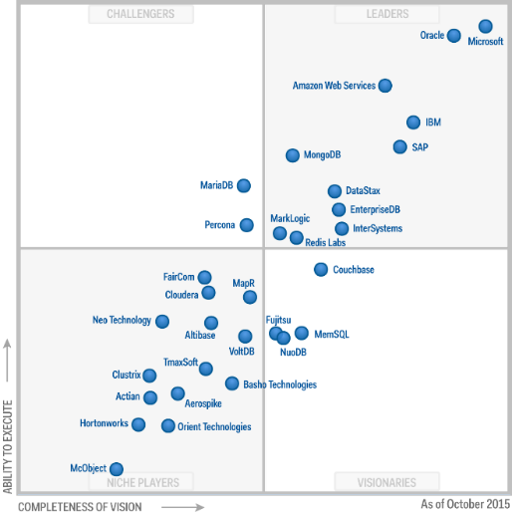
Microsoft SQL Server
DATABASE ENGINE
SQL Server Database Engine Relational and non-relational, scalable database engine with support for ANSI SQL-datatypes, XML, JSON, Spatial, binary, image, filetable and filestream. Polybase support for seamless querying of Hadoop or Azure Blob storage.
In-Memory In-memory across all workloads with in-memory OLTP, columnstore, and memory optimization with query store and resource workload management.
StretchDB Flexible and scalable database solution with scalability of data to cloud based data storage and querying.
Security Most secure data platform supporting transparent data encryption (at rest), on the wire encryption (Always Encrypted), Data Masking with full auditing, compliance and industry certification. Integrated user role based management, separation of duties, access management and row level security.
Automation Agent based integration execution of jobs/tasks executing including managed backup and backup to Azure.
High-Availability and Disaster Recovery On-Premises, Hybrid and cloud based high availability and disaster recovery solution using failover clustering, AlwaysOn Availability Groups, data replication, log shipping.
Database Engine
BI and Advanced Analytics
SQL Server Database Engine
Relational, XML, JSON, Spatial, FullText, Binary, Image, FileTable, Filestream
Row level security, Transparent Data Encryption, Always Encrypted, Data Masking, Auditing, Compliance
Analysis Services
Tabular, Multi-Dimensional
PowerPivot, BISM, Data Mining, KPI
In-Memory
SQL Agent, Database Mail, Linked Servers, Managed Backup, Backup to Azure
Reporting Services Native, SharePoint Integrated
Buffer Pool Ext.
Columnstore
Query Store
Row Store
R Services
StretchDB
Resource Governor
Information Management & Data Orchestration
HA/DR
Data Warehousing
Dimensional Modeling, Star, Snowflake, Polybase
Data Quality Services
AlwaysOn
Master Data Services
Replication
Integration Services
Log Shipping
FCI
AG
Reference Architectures
Appliances
Polybase
Physical / Virtual Deployment
Polybase
APS Massively Parallel Processing

Slide 8
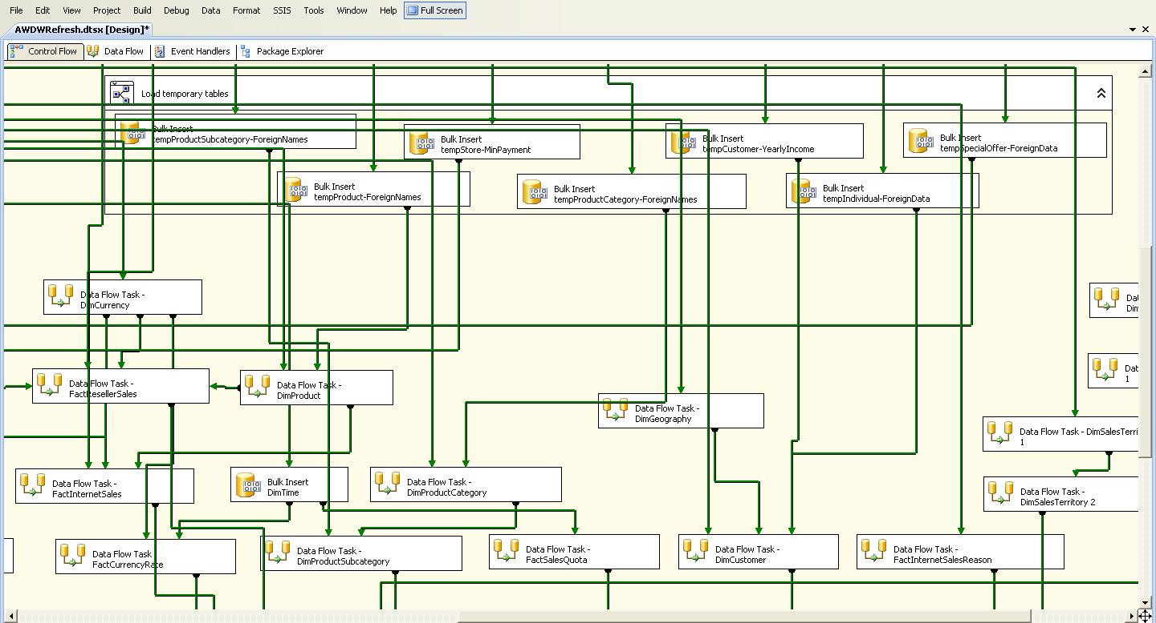
Microsoft SQL Server
INFORMATION MANAGEMENT & DATA ORCHESTRATION
Data Quality Services Data Cleansing, Matching, Reference, Profiling, Monitor, Knowledgebase
Master Data Services Comprehensive Master Data Management (MDM) solution
Integration Services High performance, scale, data integration solution (ETL/ELT) tool supporting a plethora of data sources through native or ODBC, OLEDB connectivity. Custom transformations, data mapping, data lookup and DQS integration.
Database Engine
BI and Advanced Analytics
SQL Server Database Engine
Relational, XML, JSON, Spatial, FullText, Binary, Image, FileTable, Filestream
Row level security, Transparent Data Encryption, Always Encrypted, Data Masking, Auditing, Compliance
Analysis Services
Tabular, Multi-Dimensional
PowerPivot, BISM, Data Mining, KPI
In-Memory
SQL Agent, Database Mail, Linked Servers, Managed Backup, Backup to Azure
Reporting Services Native, SharePoint Integrated
Buffer Pool Ext.
Columnstore
Query Store
Row Store
R Services
StretchDB
Resource Governor
Information Management & Data Orchestration
HA/DR
Data Warehousing
Dimensional Modeling, Star, Snowflake, Polybase
Data Quality Services
AlwaysOn
Master Data Services
Replication
Integration Services
Log Shipping
FCI
AG
Reference Architectures
Appliances
Polybase
Physical / Virtual Deployment
Polybase
APS Massively Parallel Processing

Slide 9
Microsoft SQL Server
BI AND ADVANCED ANALYTICS
Database Engine
BI and Advanced Analytics
Analysis Services Tabular (DAX), in-memory data model for high speed data processing Flexible and scalable multi-dimensional model (MDX) Data mining algorithms and querying (DMX), scorecarding (KPI)
Reporting Services Paginated, enterprise reporting with data-driven subscription mechanism, automatic report rendering with HTML 5-compliant browser support and automatic report delivery and notifications. Scheduled refresh and direct-query data sources. Native Report Manager and Portal or SharePoint Integrated.
R Services
Scalable, in-database analytics providing big data statistics, predictive modeling and machine learning capabilities based on Open Source R. Compatible with R Scripts, functions and CRAN packages while extending R to analyze data at enterprise scale through multithreading support, directly integrated within the database Engine.
R-Server
Broadly deployable enterprise-class analytics platform based on R supporting multi-platform environment, in-Hadoop and in-Teradata predictive modeling. IDE for data scientist developers, secure and scalable R Deployment, consists of DeployR, DevelopR, ConnectR, ScaleR leveraging open source and licensed components.
Data Warehousing Support for dimensional modeling, star schema, snow flake schema with querying of non-relational HDFS based data sources and MPP Scaleout through Advanced Analytics Platform System (APS) Appliance architecture with shared-nothing architecture supporting petabytes of data and Polybase integration.
SQL Server Database Engine
Relational, XML, JSON, Spatial, FullText, Binary, Image, FileTable, Filestream
Row level security, Transparent Data Encryption, Always Encrypted, Data Masking, Auditing, Compliance
Analysis Services
Tabular, Multi-Dimensional
PowerPivot, BISM, Data Mining, KPI
In-Memory
SQL Agent, Database Mail, Linked Servers, Managed Backup, Backup to Azure
Reporting Services Native, SharePoint Integrated
Buffer Pool Ext.
Columnstore
Query Store
Row Store
R Services
StretchDB
Resource Governor
Information Management & Data Orchestration
HA/DR
Data Warehousing
Dimensional Modeling, Star, Snowflake, Polybase
Data Quality Services
AlwaysOn
Master Data Services
Replication
Integration Services
Log Shipping
FCI
AG
Reference Architectures
Appliances
Polybase
Physical / Virtual Deployment
Polybase
APS Massively Parallel Processing

Slide 10
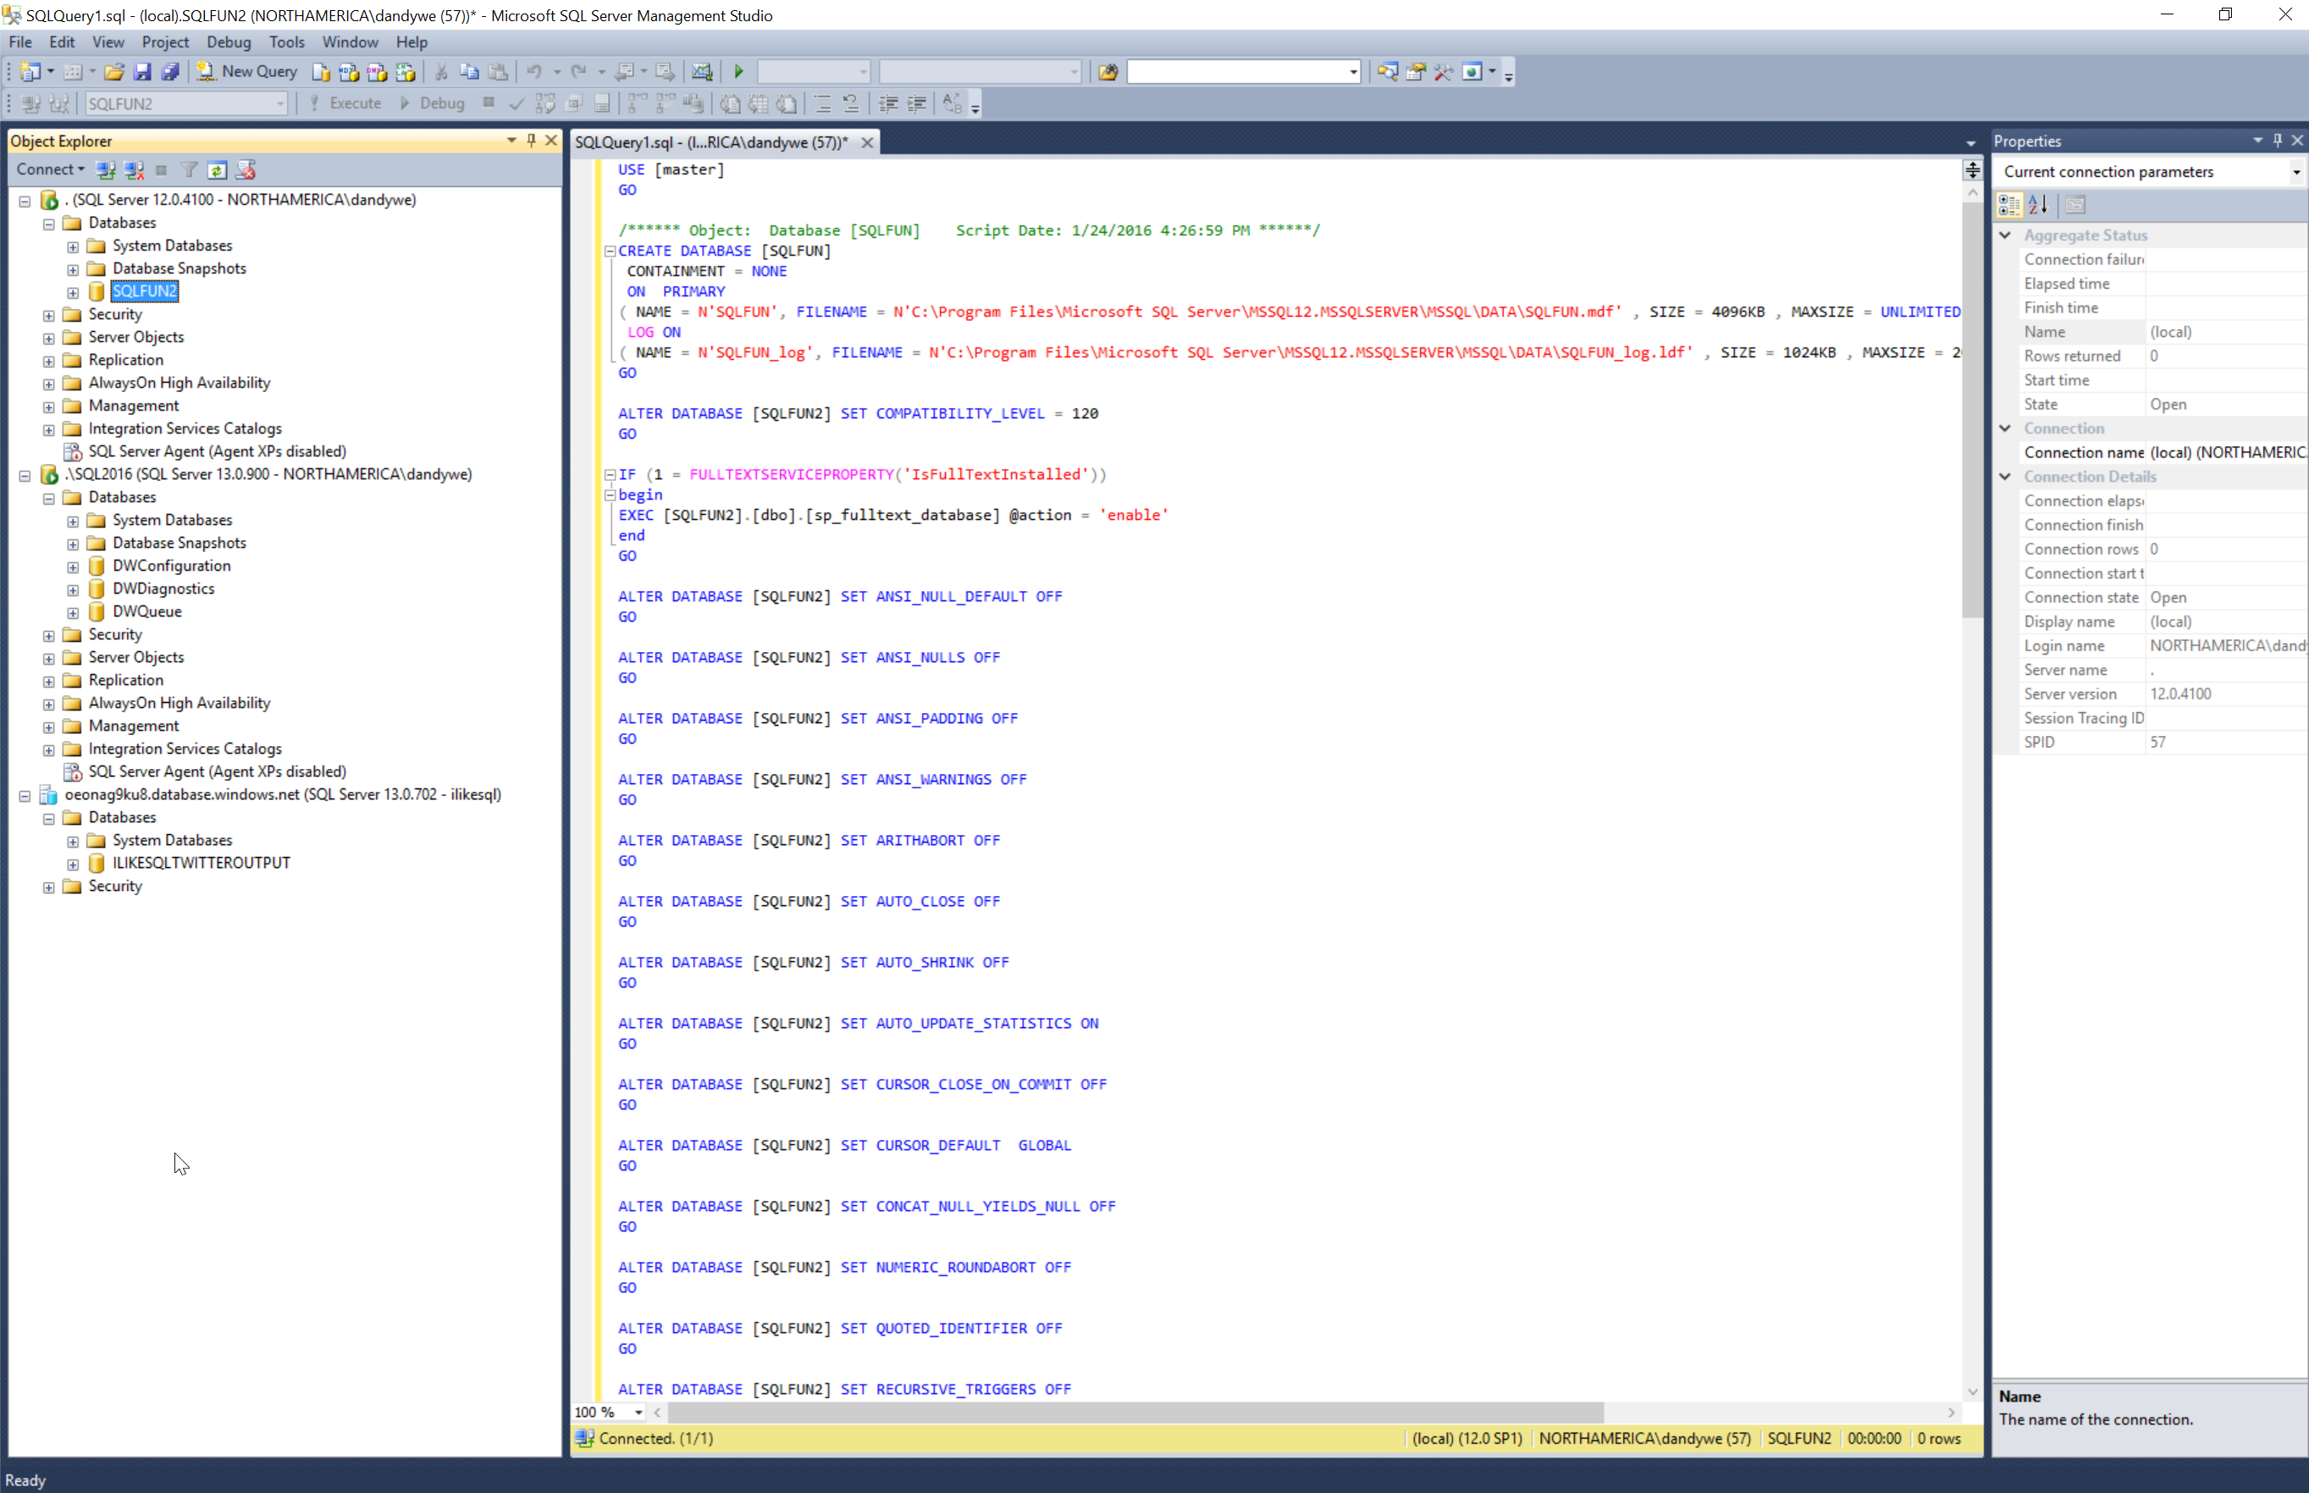
Common tools
Common Tools
SQL Server Management Studio
SQL Server Data Tools
Command Line (PowerShell, BCP, SQLCMD)
Migration & Upgrade Tools (SSMA, Upgrade Advisor, Map Toolkit)
SQL Server Management Studio
Tool for configuring, managing, and administering components within Microsoft SQL Server across on-premises and cloud-based deployments of SQL Server as well as SQL Database. Components include Object Explorer, Data Migration Wizard, Import/Export Data Tier applications, AlwaysOn Availability group administration with Add Replica Wizard, Query Analyzer, Index Tuning Advisor, Activity Monitor, Replication Monitor, and Replication Wizard.

Slide 11
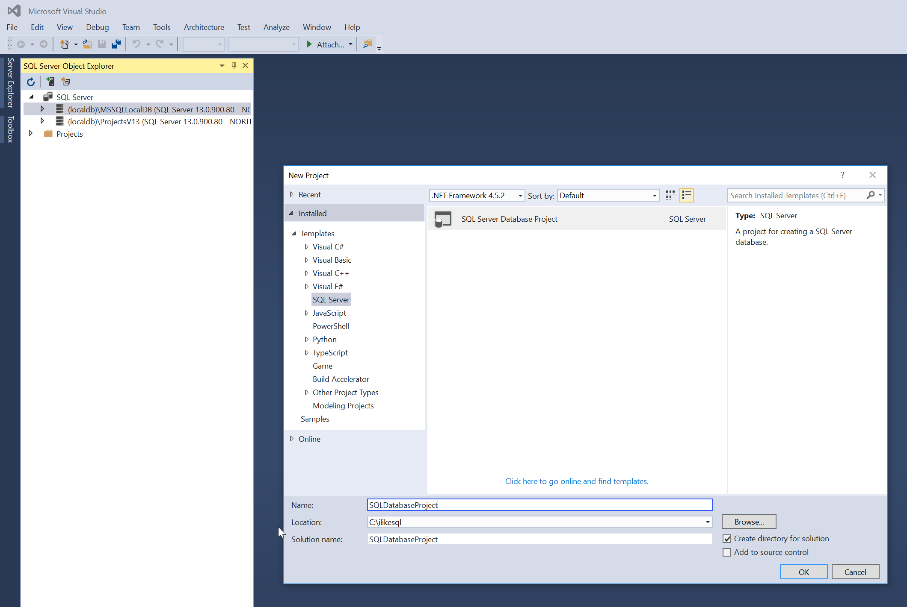
Common tools
Common Tools
SQL Server Management Studio
SQL Server Data Tools
Command Line (PowerShell, BCP, SQLCMD)
Migration & Upgrade Tools (SSMA, Upgrade Advisor, Map Toolkit)
SQL Server Data Tools
SSDT Database projects provide an integrated environment for database developers to carry out all their database design work for any SQL Server platform (both on- and off-premise) within Visual Studio (IDE). Database developers can use the SQL Server Object Explorer in VS to easily create or edit database objects and data, or execute queries, as well as deployment. Features include schema comparison and deployment testing.
SSDT-BI provides an integrated environment for development of BI solutions within the Microsoft Data Platform. This includes analysis services, data mining, integration services, and reporting projects.
In SQL Server 2016, SSDT is a single, integrated tool running as part of Visual Studio or VS Shell to perform both SSDT database projects and SSDT-BI projects.

Slide 12
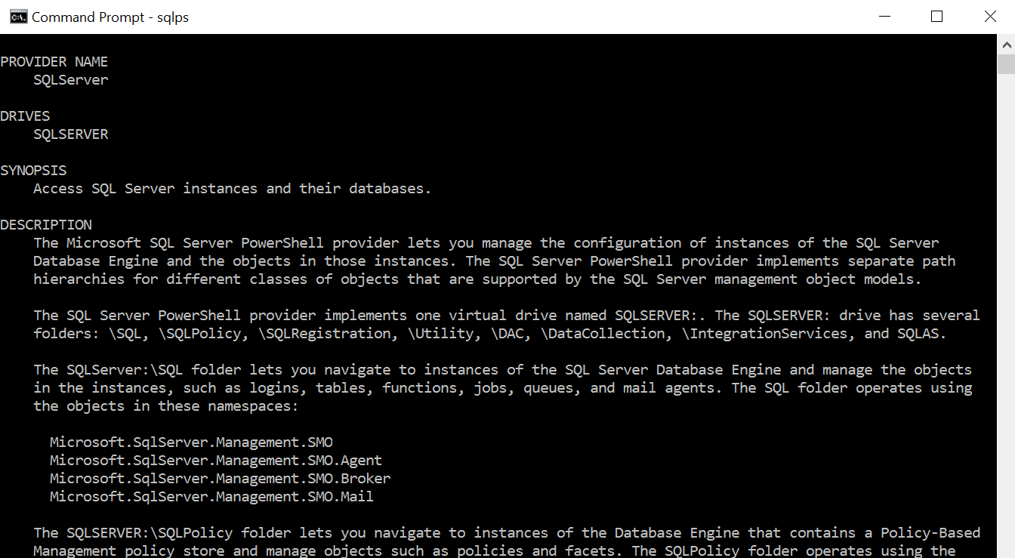
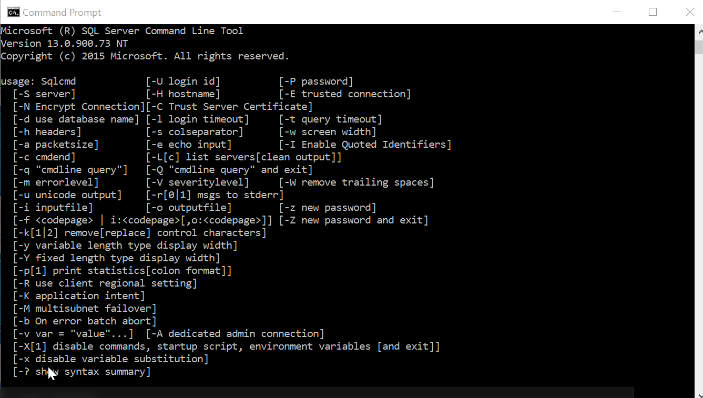
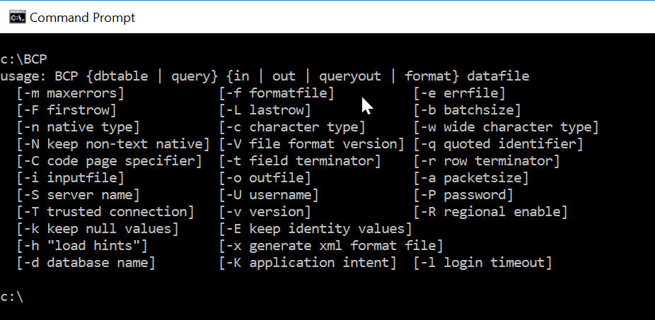
Common tools
Common Tools
SQL Server Management Studio
SQL Server Data Tools
Command Line (PowerShell, BCP, SQLCMD)
Migration & Upgrade Tools (SSMA, Upgrade Advisor, Map Toolkit)
Command Line Tools
PowerShell
Set of libraries to manage SQL Server in PowerShell and deploy SQL Server/SQL Database to Azure.
BCP Command Line utility to fast load/extract data into SQL Server.
SQLCMD Command Line mode utility to perform database operations, batch jobs, T-SQL functionality from the command line.
DWLOADER Command line mode utility to fast load data into Analytical Platform System (APS).

Slide 13
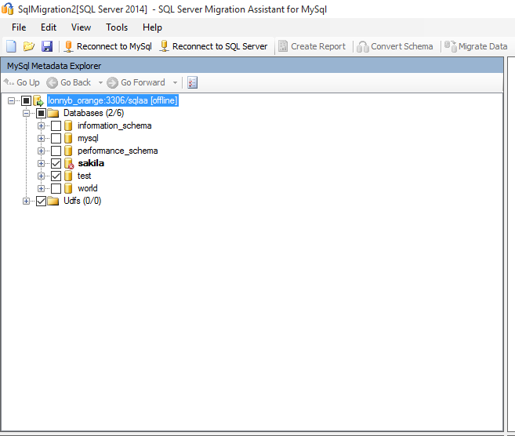
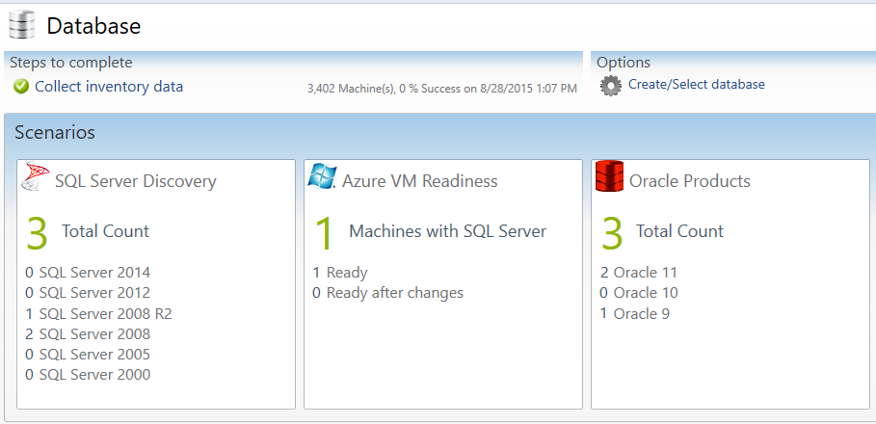
Common tools
Common Tools
SQL Server Management Studio
SQL Server Data Tools
Command Line (PowerShell, BCP, SQLCMD)
Migration & Upgrade Tools (SSMA, Upgrade Advisor, Map Toolkit)
Migration and Upgrade Tools
SQL Server Migration Assistant Platform migration tool to migrate from Oracle, Sybase, DB2, MySQL, Access to SQL Server or Azure SQL Database. Estimates migration effort, performs schema and data migration.
Microsoft Assessment and Planning Toolkit (MAP) Agentless discovery of IT resources and asset inventory across the enterprise, including discovery of non-Windows Operating Systems, Oracle Database Instances, SQL Server Instances and databases.
SQL Azure Migration Wizard Tool designed to help you migrate your SQL Server 2005/2008/2012/2014 databases to Azure SQL Database using bcp.

Slide 14
Demo
SQL Server Tools

Slide 15
Cloud data offerings
LRS – Geo-Replication
SQL Server in Azure VM Run SQL Server workloads in Azure Virtual Machines (IaaS).
SQL Database Database as a Service Offering running on Azure, providing multiple tiers of storage and performance including high availability and elastic scale.
Azure Marketplace Azure offering for certified, open source, and community software applications, developer services, and data including compute and storage. Pre-configured and easy to deploy for Microsoft Azure.
DocumentDB Azure DocumentDB is a NoSQL document database service with native support of JSON and JavaScript inside the database engine.
Table Storage Non-relational, key-value-pair, storage system suitable for storing unstructured data.
Blob Storage Service for storing large amounts of unstructured data, such as text or binary data, that can be accessed from anywhere in the world via HTTP or HTTPS. Storage accounts are used for database backups to Azure, VHD files related to SQL Server in Azure VM.
Redis Cache
Separate, distributed cache layer leveraging low-latency, high-throughput capabilities of the advanced key-value store Redis engine. Allows data tier to scale independently for more efficient use of compute resources in the application layer.
CLOUD
SQL Server in Azure VM
SQL Database + Elastic Scale
Azure Marketplace
DocumentDB
Redis Cache
Azure HDInsight
Map Reduce, Pig, Hive, Hbase, Storm, Spark
Blob Storage
Table Storage
MPP
Azure SQL Data Warehouse
Azure Data Lake Store
Azure Data Factory
Azure Data Catalog
Azure Search
Event Hub
Stream Analytics
Azure Data Lake Analytics
Azure ML

Slide 16
Cloud data offerings
LRS – Geo-Replication
Azure HDInsight Azure HDInsight deploys and provisions managed Apache Hadoop clusters in the cloud. HDInsight uses the Hortonworks Data Platform (HDP) Hadoop distribution. HDInsight includes HBase, Spark, and Storm, as well as other technologies under the Hadoop umbrella.
Azure SQL Datawarehouse Enterprise-class, distributed database capable of processing massive volumes of relational and non-relational data. Massive scale through MPP (Massively Parallel Processing). Fast deployment and scale.
Azure Data Lake Store Hyper-scale repository for big data analytic workloads in the cloud. Compatible with HDFS, unbounded scale with massive throughput and enterprise-grade capabilities.
Azure Data Factory Data Movement and orchestration service in the cloud used to ingest data from multiple on-premises and cloud-based data sources.
Azure Data Catalog Enterprise-wide metadata catalog that enables data source discovery that lets any user—from analyst to data scientist to data developer—register, enrich, discover, understand, and consume data sources.
Azure Search Azure Search capability as a service enabling search-based applications. Provides search capability such as type-ahead suggestions, hit highlighting, and faceted navigation; supports the linguistic features that are appropriate to specified language.
CLOUD
SQL Server in Azure VM
SQL Database + Elastic Scale
Azure Marketplace
DocumentDB
Redis Cache
Azure HDInsight
Map Reduce, Pig, Hive, Hbase, Storm, Spark
Blob Storage
Table Storage
MPP
Azure SQL Data Warehouse
Azure Data Lake Store
Azure Data Factory
Azure Data Catalog
Azure Search
Event Hub
Stream Analytics
Azure Data Lake Analytics
Azure ML

Slide 17
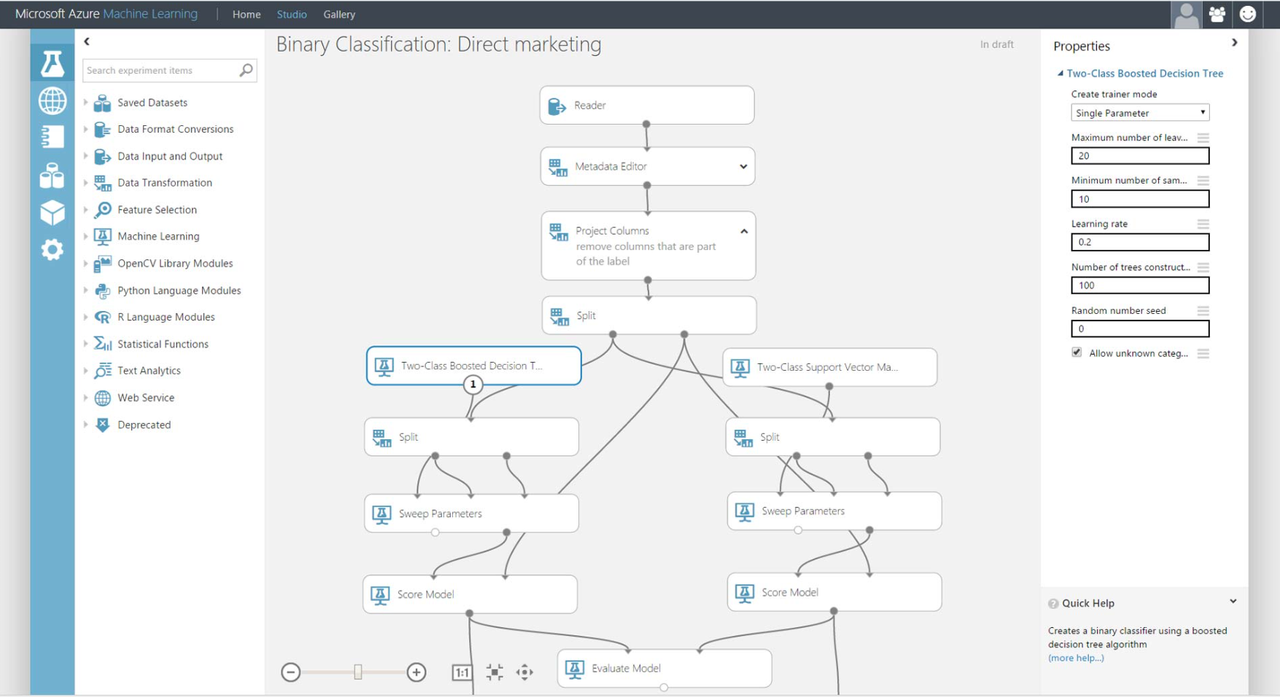
Cloud data offerings
LRS – Geo-Replication
Event Hub Highly scalable publish-subscribe service that can ingest millions of events per second and stream them into multiple applications. Supports processing and data collection and storage by using real time analytics providers such as Stream Analytics and batch storage adapters.
Stream Analytics Real-time analytics supporting millions of events per second used to develop low-cost solutions to gain real-time insights from devices, infrastructure, and applications such as IoT scenarios.
Azure Data Lake Analytics Data analytics on terabytes or even exabytes of data. Dynamically provisioned resources using U-SQL query language that extends the familiar, simple, declarative nature of SQL with the expressive power of C# across distributed systems.
Azure Machine Learning A fully managed cloud service that enables you to easily build, deploy, and share predictive analytics solutions.
LRS – Geo-Replication
CLOUD
SQL Database + Elastic Scale
SQL Server in Azure VM
SQL Database + Elastic Scale
SQL Server in Azure VM
Azure Marketplace
Azure Marketplace
Redis Cache
DocumentDB
Redis Cache
Document DB
Azure HDInsight
Azure HDInsight
Map Reduce, Pig, Hive, Hbase, Storm, Spark
Map Reduce, Pig, Hive, Hbase, Storm, Spark
Blob Storage
Blob Storage
Table Storage
Table Storage
MPP
MPP
Azure SQL Data Warehouse
Azure Data Lake Store
Azure SQL Datawarehouse
Azure Data Lake
Azure Data Catalog
Azure Data Catalog
Azure Data Factory
Azure Data Factory
Azure Search
Azure Search
Stream Analytics
Stream Analytics
Azure Data Lake Analytics
Azure Data Lake Analytics
Azure ML
Event Hub
Azure ML
Event Hub

Slide 18
Data visualizations
Analyze and Authoring
Delivery
Consume
Analytical Reports
Cloud
Power BI Web Portal
Microsoft Excel
Power BI Service
Power BI Desktop
On-Premises
Windows Phone App
SQL Reporting Services
Android App
Mobile Reports
Mobile Report Publisher
iOS App
Paginated Reports
Reporting Services Portal
Report Builder
SharePoint
Report Designer
Cortana
Analytical Reports - Excel Use the power of Excel for Analytics, forecasting, data ingestion using Power Query, PowerPivot, import model in Power BI Desktop. Visualize Excel Data through publication and embedding in Power BI Dashboards delivered through the Power BI Service. Power BI Desktop Connect to databases using cached or live data connections, csv, text, xml and unstructured data, Azure cloud data sources, R, SalesForce, Google Analytics, Github, HDFS and many more. Deliver rich visualizations including custom visuals. Publish through Power BI Service and consume through Web Portal or native apps.
Mobile Report Publisher Build rich mobile first data visualizations, publish to Reporting Services Portal and consume from native applications or portal.
Paginated Reports Traditional corporate reporting, paginated reports built for delivery through SQL Reporting Services. Pin Reports to Power BI dashboards.

Slide 19
Data visualizations
Analyze and Authoring
Delivery
Consume
Analytical Reports
Cloud
Power BI Web Portal
Microsoft Excel
Power BI Service
Power BI Desktop
On-Premises
Windows Phone App
SQL Reporting Services
Android App
Mobile Reports
Mobile Report Publisher
iOS App
Paginated Reports
Reporting Services Portal
Report Builder
SharePoint
Report Designer
Cortana
Power BI Service Power BI Service is the cloud-based backbone component of Power BI. Publish Power BI Desktop files, pin Paginated Reports, create dashboards and enable sharing and collaboration through the service. Service handles scheduled data refresh, natural language query, shared access, REST API calls. SQL Server Reporting Services Publish Paginated reports and Mobile Reports to SQL Server Reporting Services, consume through the Reporting Services Portals.
Power BI Web Portal Consume published reports and dashboards through the Power BI Web Portal, pin Paginated Reports to the dashboard, analyze data using natural language query (Q&A).
Native Apps for Mobile platforms Consume Power BI dashboards and reports, drill down into Paginated Reports, KPIs, collaborate and annotate using native apps for all mobile platforms (Windows Phone, iOS, Android).
SharePoint Embed reports in SharePoint Web.
Cortana Integrate with Cortana personal assistant, ask and query using voice to retrieve analysis and reporting with integration in Windows 10.

Slide 20


Cortana Analytics Suite
Information Management
Big Data Stores
Machine Learning and Analytics
Dashboards and Visualizations
Business apps
Power BI
Azure
Data Factory
Azure
Machine Learning
Personal Digital Assistant
Azure
Data Lake
Cortana
People
Custom apps
Azure
Data Catalog
Azure
HDInsight (Hadoop)
Perceptual Intelligence
Azure
SQL Data Warehouse
Face, vision
Azure
Stream Analytics
Speech, text
Azure
Event Hub
Business Scenarios
Sensors and devices
Azure
Data Lake Analytics
Recommendations,
customer churn,
forecasting, etc.
Automated Systems
DATA
INTELLIGENCE
ACTION

Slide 21
Demo
Microsoft Business Intelligence

